Slide 1

Churn in SyriaTel Company
By Patriciah Nici Mboya

Slide 2

INTRODUCTION
SyriaTel, a telecommunications company seeks to predict whether a customer will soon stop doing business with them.
The question we are therefore asking ourselves is:: are there any predictable patterns here?

Slide 3
PROJECT GOAL
Identify customers churn and provide recommendations to SyriaTel that will direct them toward such customers, providing adequate intervention to encourage them to stay and minimize customer exit

Slide 4
DATA
SyraTel Churn Telcom Dataset was obtained from [https://www.kaggle.com/datasets/becksddf/churn-in-telecoms-dataset]
The dataset consists of cleaned customer activity data (features), along with a churn label(target) specifying whether a customer canceled the subscription
In the context of this project, this is a problem of supervised classification and Machine Learning algorithms will be used for the development of predictive models and evaluation of accuracy and performance. It seeks to find the most appropriate model for the business.

Slide 5
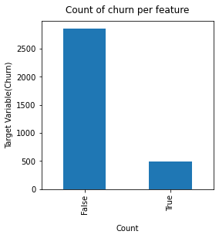
Analysis of Churn
Churn has two categories which include True and False values. (True = Customer who churned, False = Customers who were retained).
There are about 85% of customers who churn, and about 14 customers who are loyal.
We can clearly see that our data is highly imbalanced. The occurence of False is higher than True.

Slide 6
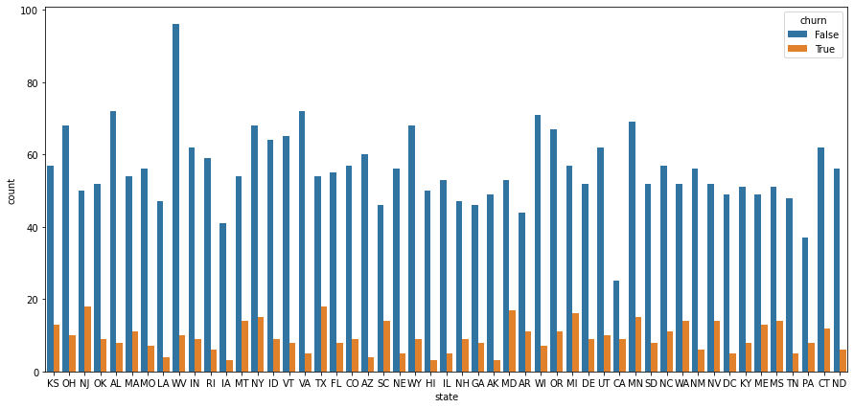
Churn according to State
The top 2 states with the highest churn rate are TX and NJ with a churn rate of 18
The top 3 states with the lowest churn rate are AK,IA and HI with a churn rate of 3

Slide 7
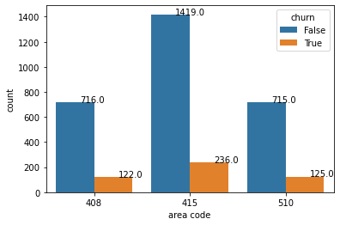
Churn according to Area
Most of the churned customers are from 415 area.
While Area codes 408 and 510 had comparatively less churned customers.

Slide 8
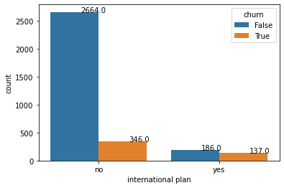
Churn according to International plan
Churn rate is more with customer using international plan.
Customers with International plan have about 42% Churn rate.
While customers who don't have International plan have about 11% Churn rate.
It is possible that the international plans might not be attractive for customers.

Slide 9
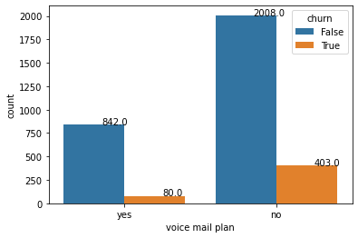
Churn according to voice-mail plan
Voice mail plan seems to be loved more among customers
We can also see that Churn rate of customer with voice mail plan is 8% which is lee than the churn of rate of customers without voice mail plan which is 16%

Slide 10
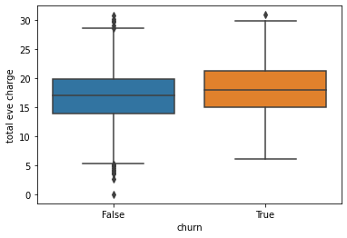
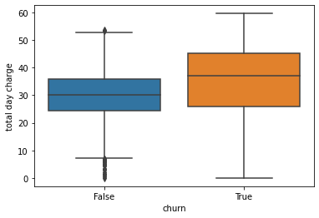
Churn according to charges
The box-plots on the left show the difference in charges during the day and during the night
We can clearly see that Charges for the day time calls are way higher than that of Evening and Night.

Slide 11
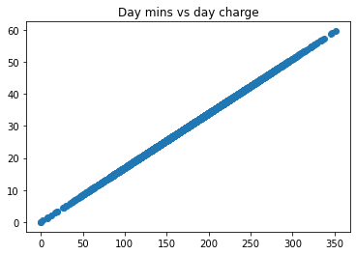
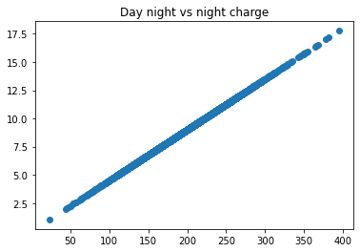
Relationship between minutes and charges
On the left we can see that there is a linear relationship between talk-time and charges,
The longer a customer talks the more he/she is charges
This may be one of the reasons why customers churn

Slide 12
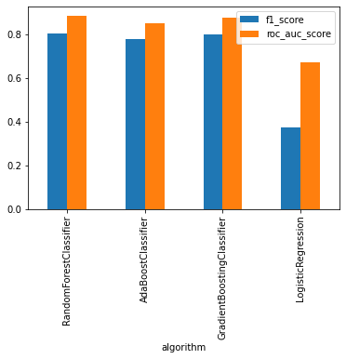
METHODS
4 different ML models were used for the development of the predictive models and evaluation of accuracy and performance.
OF the 4 classifiers the one that appropriately solved the business problem was the RandomForestClassifier
ACCURACY 0.94

Slide 13
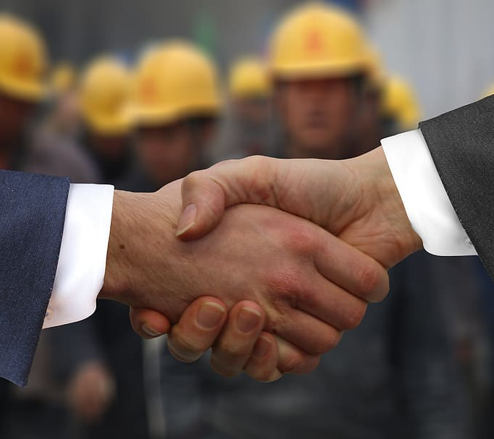
RECOMMENDATIONS
good way to lower churn is to lower the prices as the talk time increases.
Have special offers for those who make more international calls.
Introduce free voice mail plans
Promote the service and its products frequently in area 415 area

Slide 14
CONCLUSION
The predictable patterns have been FOUND
Customers churn the SyriaTel due to:
High prices for increase in talk-time
High charge rates for international calls
The service and products are not well marketed in some areas

